Slide 1






Bootcamp
FAMOUS PEOPLE IN IT
Basic Level
CAROLINA GOMEZ M.
MAY 20th, 2024

Slide 2
Table of content
1
Welcome
2
IT Vocabulary
3
IT Characters

Slide 3
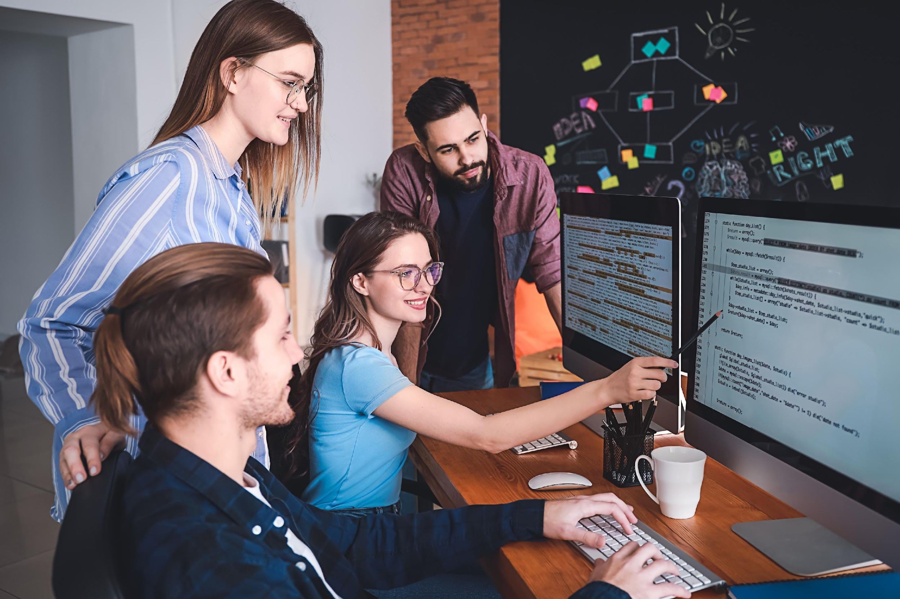

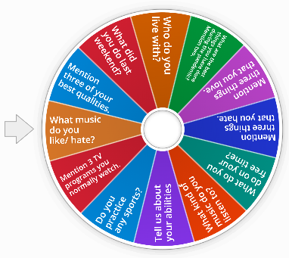
Welcome
Let’s get to know each other.
You can use the chat to answer or raise your hand to speak.
https://wordwall.net/es/resource/20078582/getting-to-know-you

Slide 4
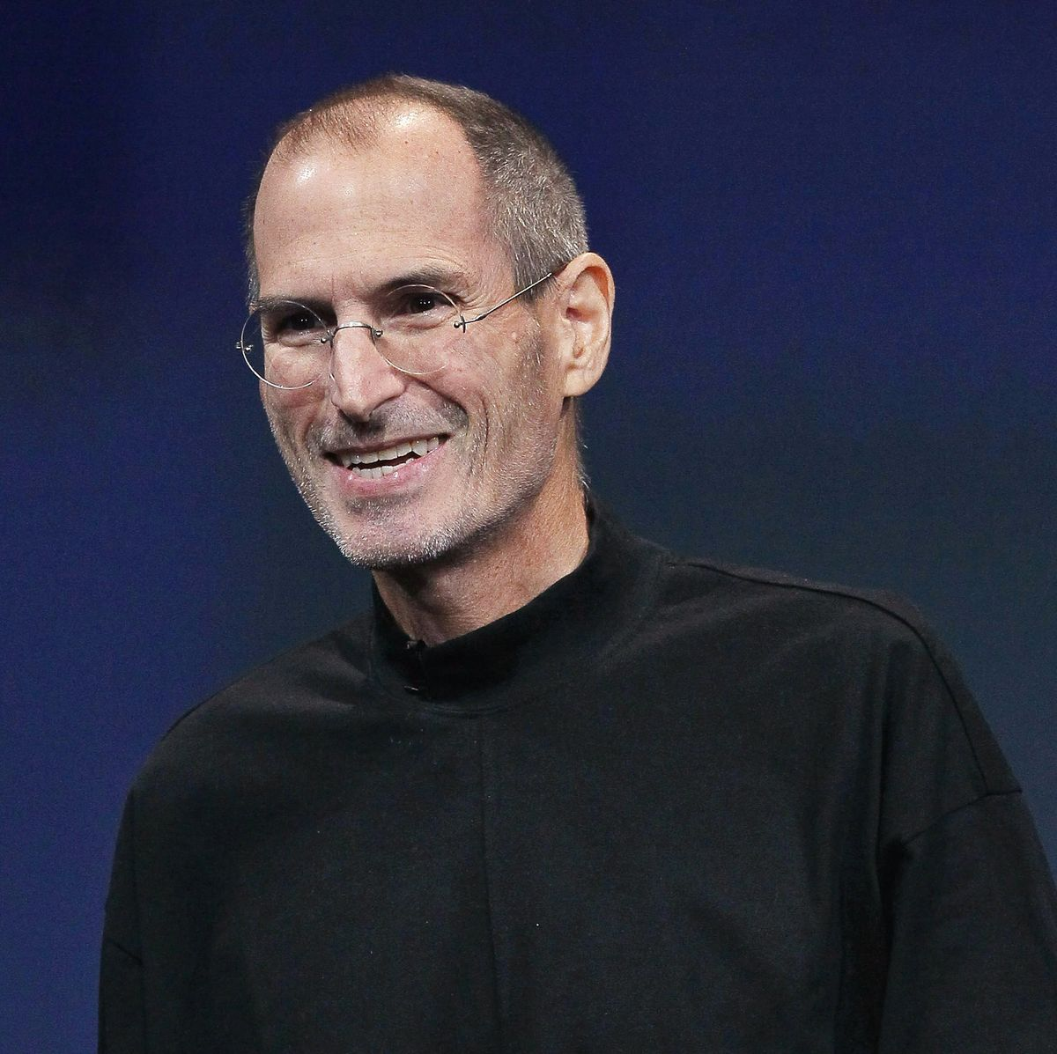
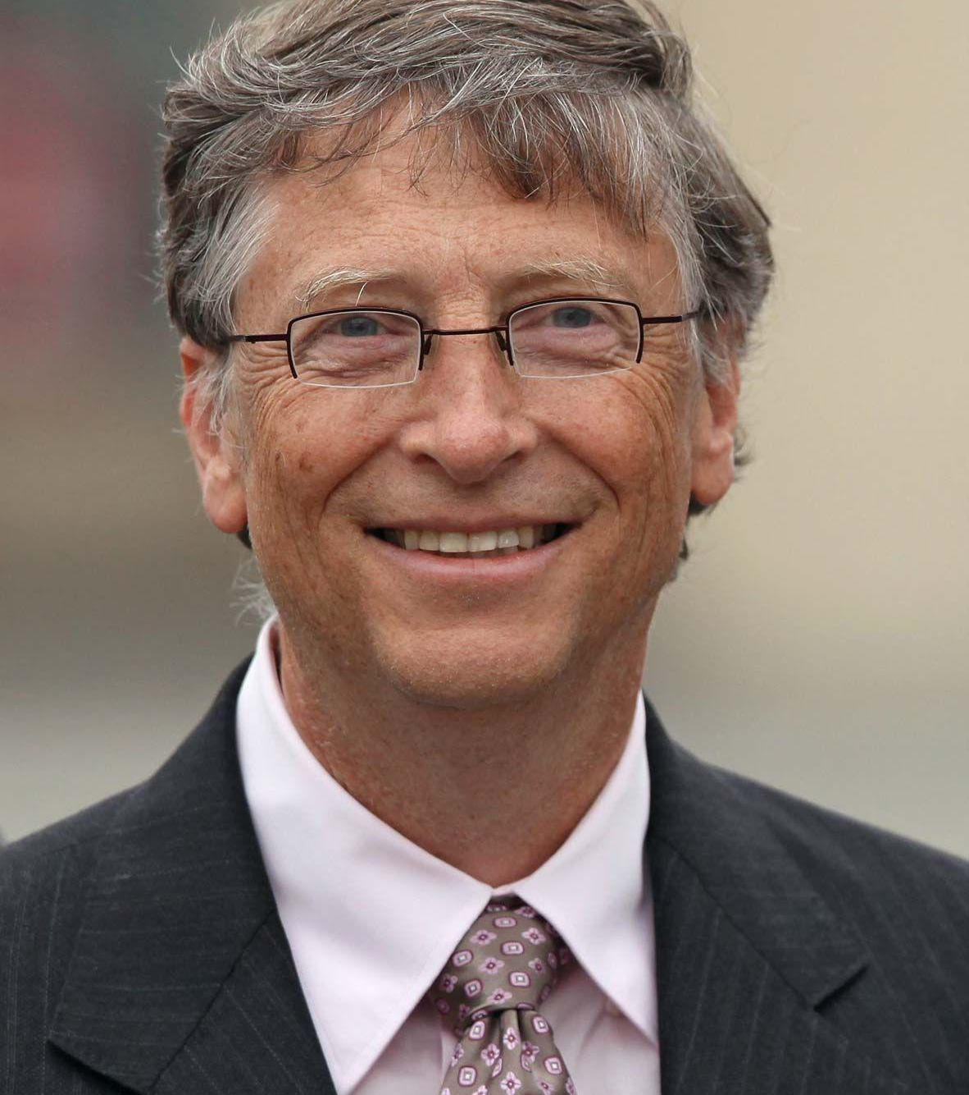
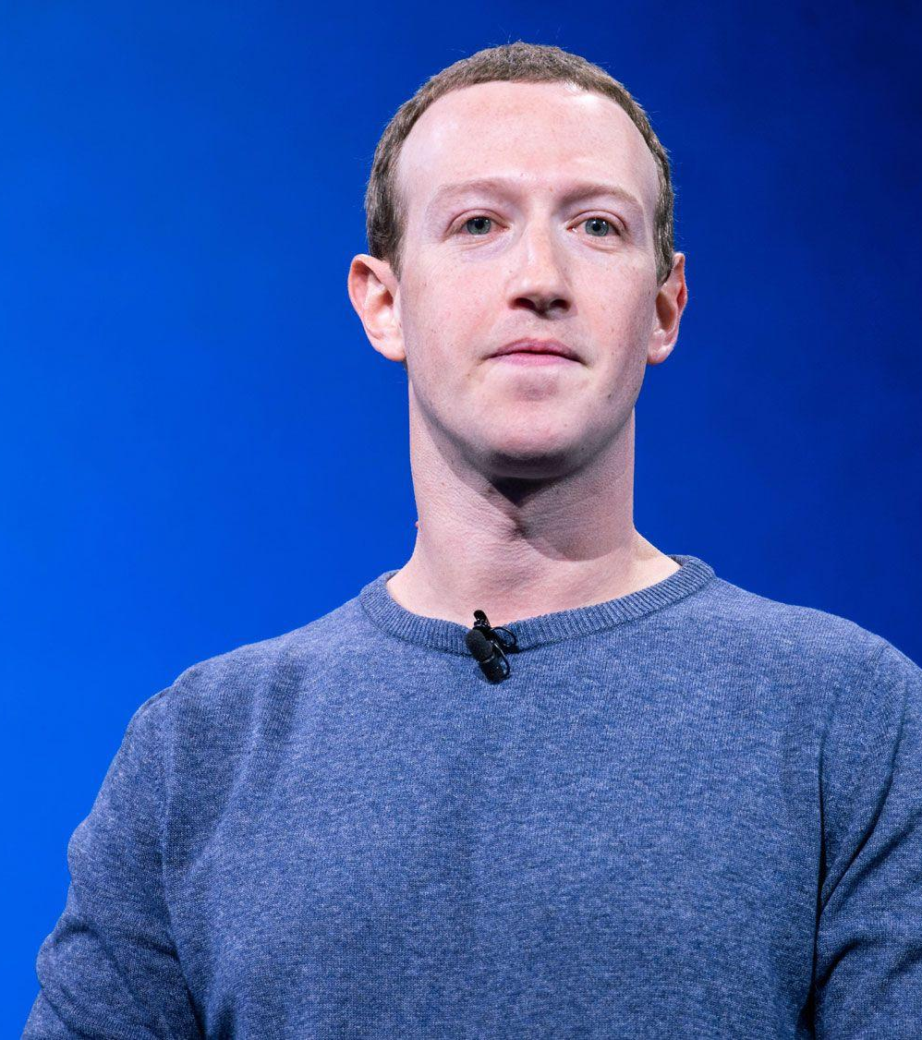
Who are they?
Steve Jobs
Bill Gates
Mark Zuckerberg
Former CEO of Apple
Former CEO of Microsoft
CEO of Facebook
Notes:
Which other influential people do you know in IT?

Slide 5

Vocabulary 1/2
Match the words with its synonym.
1. | received | a. | invention
2 | leading | b. | attended
3. | discovery | c. | top
4. | build | d. | stopped
5. | went to | e. | got
6. | banned | f. | make

Slide 6
Vocabulary 2/2
Match the words with its synonym.
7. | based on | g. | Internet
8. | string | h. | presently
9. | improve
10. | now | i. | centered around
11. | Web | j. | series
 |  | k. | upgrade

Slide 7
Vocabulary 1/2
Match the words with its synonym.
1. | received | a. | invention
2 | leading | b. | attended
3. | discovery | c. | top
4. | build | d. | stopped
5. | went to | e. | got
6. | banned | f. | make

Slide 8
Vocabulary 2/2
Match the words with its synonym.
7. | based on | g. | Internet
8. | string | h. | presently
9. | improve
10. | now | i. | centered around
11 | Web | j. | series
 |  | k. | upgrade

Slide 9
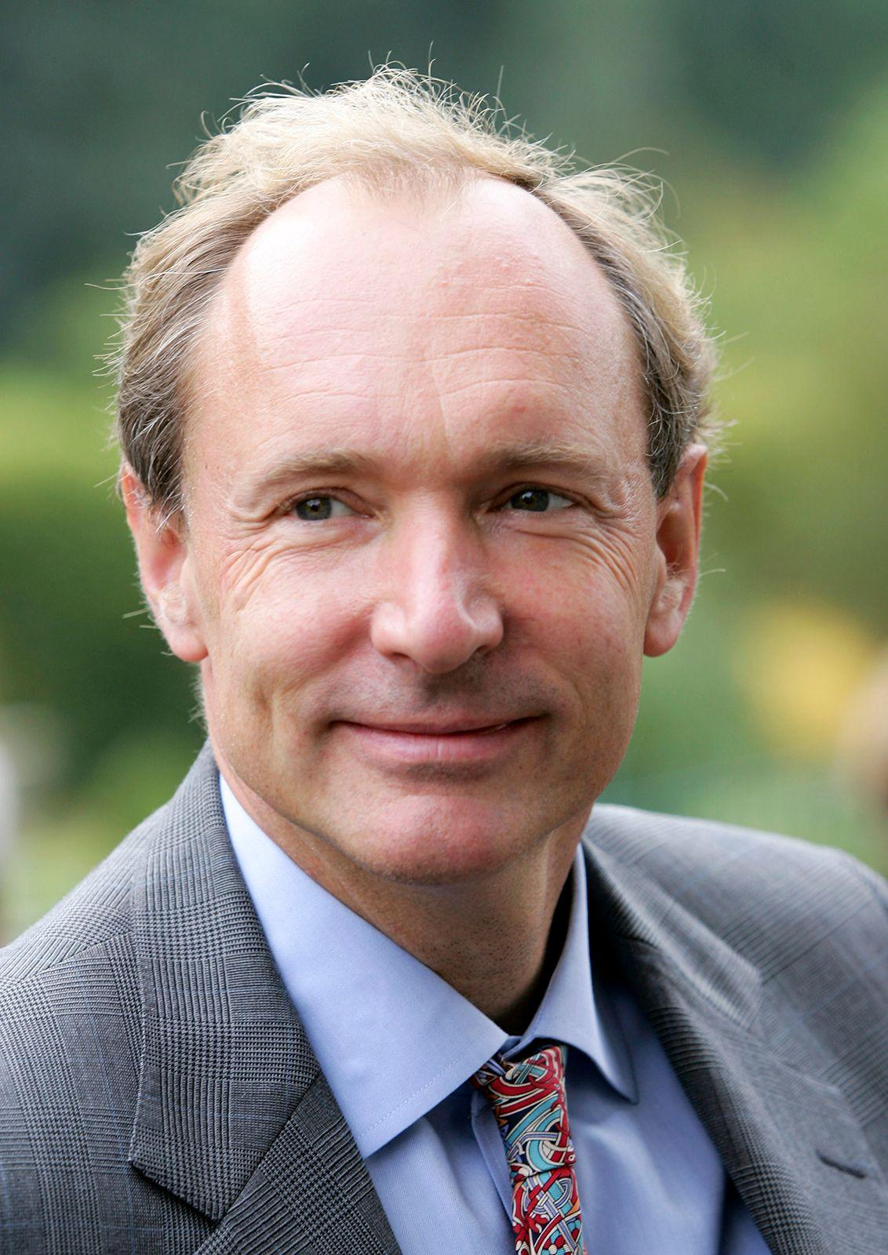
Tim Bernes-Lee
Sir Timothy Berners-Lee is a British computer scientist who invented the World Wide Web. He received a knighthood from the British Queen for his efforts (so he is called ‘Sir’). He is director of W3C, which looks after the Web’s development. A leading British newspaper ranked him as the world’s greatest living genius. Today’s world would be very different without his discovery.
Berners-Lee was born in 1955 to parents who were mathematicians and computer scientists. He grew up with numbers and electronics and managed to build his own computer. He went to Oxford University and was banned from using the computers for hacking. Berners-Lee graduated with a degree in physics. His first jobs after graduating were as a computer programmer and software developer.
Berners-Lee spent the 1980s on a project based on sharing and updating information online. In 1991, he put the first website online. It explained what the World Wide Web was and how it was used. He gave his idea to the world for free. In 1994, Berners-Lee founded W3C to set standards and improve the quality of the Web.
Berners-Lee now spends his time between W3C and as a professor of computer science in England. He also writes about the future of the Web. In 2004, he was named as the first ever winner of the Millennium Technology Prize. He has a string of other awards and is listed as one of ‘Time’ magazine’s 100 most important people of the 20th Century.

Slide 10
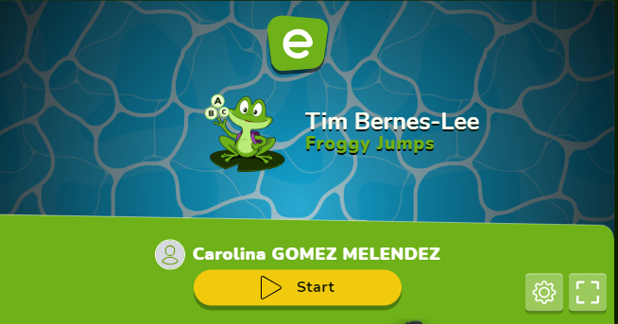
Questions
https://es.educaplay.com/recursos-educativos/18365567-tim_bernes_lee.html
Notes:
Answers to the comprehension questions:
1. Sir Timothy Berners-Lee invented the World Wide Web.
2. Berners-Lee received a knighthood from the British Queen for his efforts in inventing the World Wide Web.
3. Berners-Lee went to Oxford University.
4. After graduating from university, Berners-Lee worked as a computer programmer and software developer.
5. The purpose of W3C, according to the text, is to set standards and improve the quality of the Web.

Slide 11
Activity 1/2
Choose the correct word in each case.
Sir Timothy Berners-Lee is a British / Briton computer scientist who invented the World Wide Web. He received a nightcap / knighthood from the British Queen for his efforts (so he is called ‘Sir’). He is director of W3C, which looks up / after the Web’s development. A leading British newspaper ranked him as the world’s greatest living genius. Today’s world would be very different without his discovered / discovery.
Berners-Lee was born in 1955 to parents who were mathematics / mathematicians and computer scientists. He grown / grew up with numbers and electronics and managed to build his own computer. He went to Oxford University and was banned / binned from using the computers for hacking.

Slide 12
Activity 2/2
Choose the correct word in each case.
Berners-Lee spent the 1980s as / on a project based on sharing and updating information online. In 1991, he put / took the first website online. It explained what the World Wide Web was and how it was using / used. He gave his idea to the world for free. In 1994, Berners-Lee founded W3C to / by set standards and improve the quality of the Web.
Berners-Lee now spending / spends his time between W3C and as / was a professor of computer science in England. He also wrote / writes about the future of the Web. In 2004, he was named as the first ever winner of the Millennium Technology Prize. He has a string / rope of other awards and is listed as one of ‘Time’ magazine’s 100 most important people of the 20th Century.

Slide 13
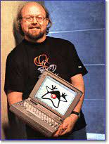
James Gosling
Born in 1955 near Calgary, Canada, Gosling is best known as the father of the Java programming language, the first programme language designed with the internet in mind. Gosling received a BSc (Bachelor of Sciences) in computer science from the University of Calgary in 1977, completed a PhD in computer science and contributed to software innovation at a technical level. While working towards his doctorate, he created the original version of the Emacs text editor for Unix (Gosmacs). He also built a multi-processor version of Unix, as well as several compilers and mail systems before starting work in the industry. In 1984, Gosling joined Sun Microsystems, where he is currently chief technology officer in the developer product group. In the early 1990s, Gosling initiated and led a project code-named Green that eventually became Java. Sun formally launched Java in 1995. Gosling did the original design of Java and implemented its original compiler and virtual machine. For this achievement he was elected to the US National Academy of Engineering. He has also made major contributions to several other software systems, such as Newa and Gosling Emacs. Java has allowed the creation of robust, reusable code which runs on devices as diverse at mobile phones, PCs and mainframes.

Slide 14
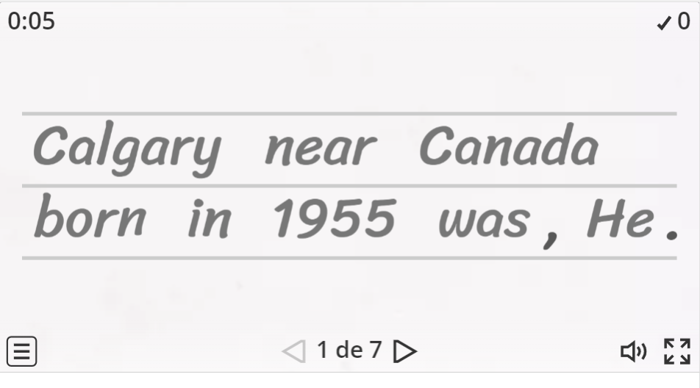
Activity
Unscramble the following sentences.
https://wordwall.net/es/resource/70416615/james-gosling
Notes:
Answers:
1. She was a pioneer in the field of radioactivity.
2. She was the first female professor at the University of Paris.
3. Big influence on Marie’s education early was.
4. Marie was an exceptional student with an amazing memory.
5. She often went without food and sleep to study.
6. He considered Marie to be a genius.
7. They spent most of their time together in their laboratory.
8. She threw herself even deeper into her work.
9. A condition caused by decades of exposure to radiation.
10. No one knew how deadly radium was.

Slide 15
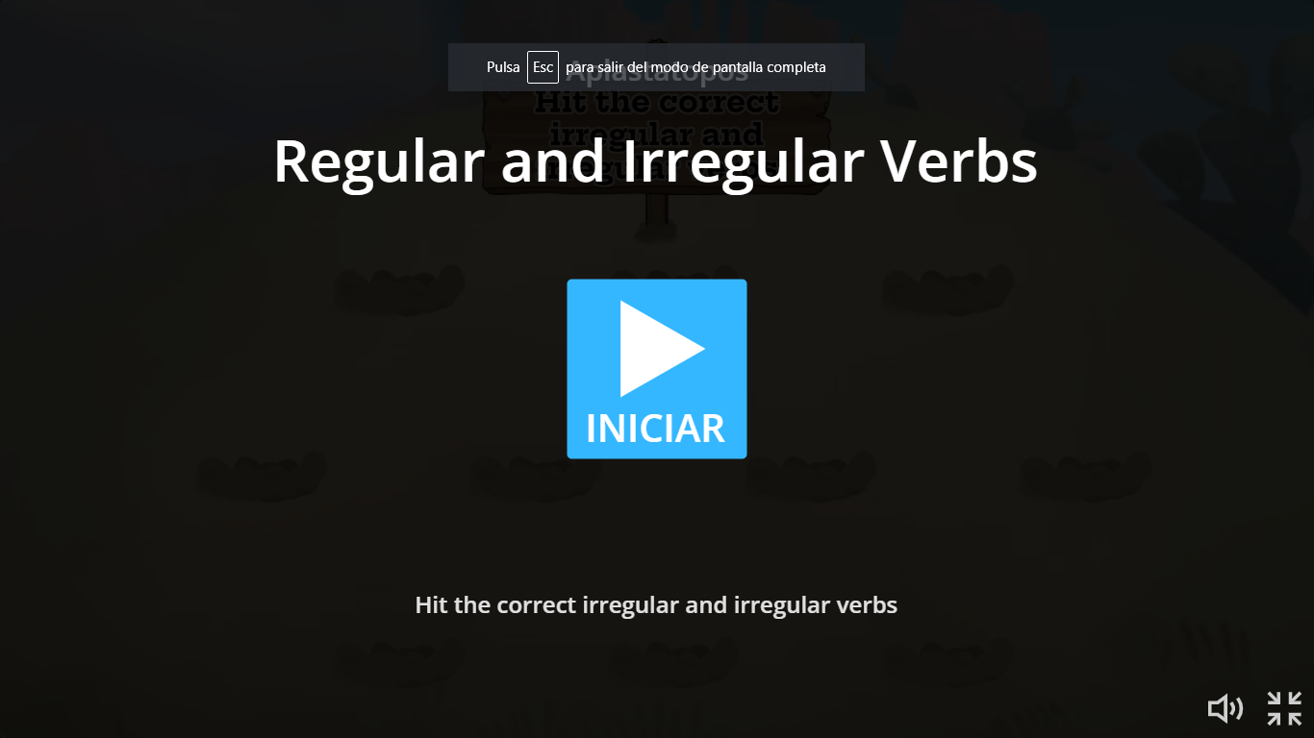
Activity
Check the verbs.
https://wordwall.net/es/resource/3256200/regular-and-irregular-verbs
Notes:
Answers:
1. She was a pioneer in the field of radioactivity.
2. She was the first female professor at the University of Paris.
3. Big influence on Marie’s education early was.
4. Marie was an exceptional student with an amazing memory.
5. She often went without food and sleep to study.
6. He considered Marie to be a genius.
7. They spent most of their time together in their laboratory.
8. She threw herself even deeper into her work.
9. A condition caused by decades of exposure to radiation.
10. No one knew how deadly radium was.

Slide 16
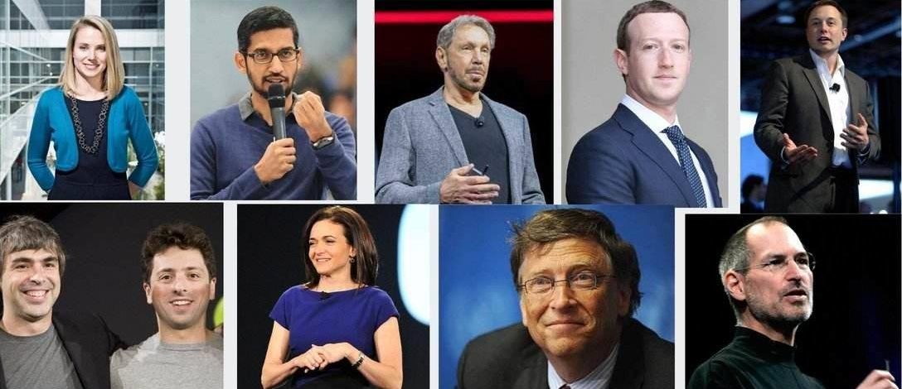
Homework # 1
Investigate about a famous person in IT and write a short paragraph (maximum 5 lines), highlighting the most important contributions he/she made for the IT world.
Word Document
Notes:
Warm up regular and irregular verbs: https://wordwall.net/es/resource/3256200/regular-and-irregular-verbs

Slide 17


